Slide 1
Applying UX Strategy in Real Scenarios
Week 1 seminar| UX Strategies

Slide 2
Session Outline
In this week’s seminar session, you will apply the following concepts from the lecture session:
  1. Understand the key component of a UX strategy.
  2. Learn to apply UX strategy in real-world scenarios.
  3. Engage in hands-on activities to reinforce learning.
The seminar is structured into 1 research and presentation activity.

Slide 3
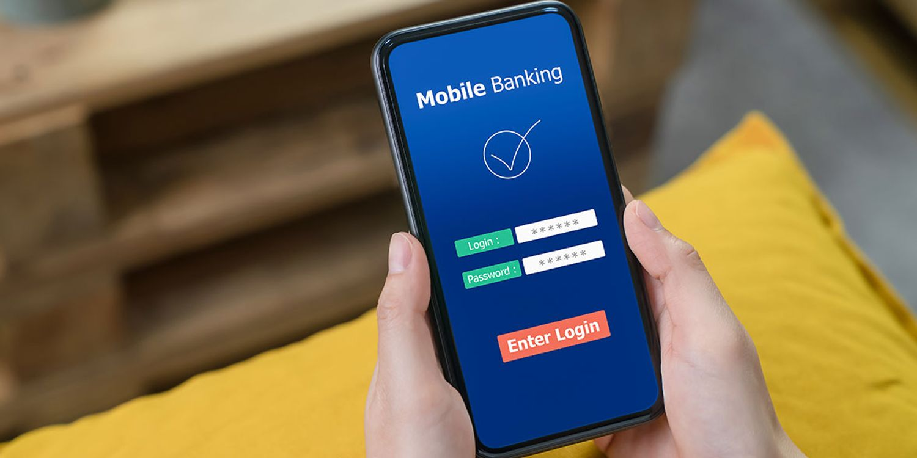
Activity 1 - Introduction: 5 mins
Context: A leading bank has received feedback that its mobile banking app is difficult to use, leading to customer frustration and increased support calls.
Goal: Improve the user experience to increase customer satisfaction and reduce support calls.
Key Areas to Focus: Simplify navigation. Streamline transaction processes. Enhance security features visibility.
Notes:
For lecturer's: Form Groups (5 mins): Divide participants into small groups,introduce scenario and give instructions (3-5 members).

Slide 4
Activity 1 - Instructions
Discuss the Scenario (5 mins): Review the scenario and identify key issues with the current app in your groups. You can use a digital tool or simple pen/paper to record your ideas.
Develop a UX Strategy (25 mins):
Use UX strategy components:
      User Research: How would you gather user feedback?
      Persona Development: Create a persona for a typical user.
      Journey Mapping: Outline the user journey for key tasks.
      Wireframing and Prototyping: Sketch initial ideas for improvements.
      Usability Testing: Plan how you would test the new designs.
3. Prepare and present an informal Presentation + Q/A (15 mins): Summarize your strategy and key improvements. Assign one group member to informally present or talk about your UX Strategy for the scenario. Class members can follow with Q/A.
4. Instructor Feedback (10 mins):In end the instructor will show you some potential results of UX Strategy that could be followed to enhance the UX of leading back mobile App.
Notes:
Start the visible timer on the screen for everyone's visibility.

Slide 5
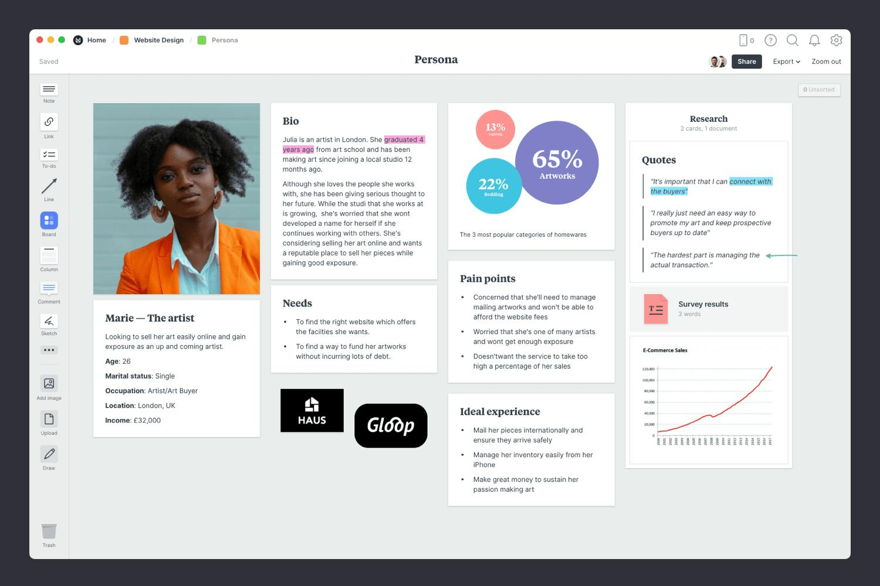
Feedback - Persona
Persona:
Sarah, 32, Working Professional:
Background: Works in marketing. Uses the app for daily banking and bill payments.
Goals: Quick and easy transactions. Secure access to account information.
Frustrations: Finds the current app navigation confusing. Often has to call support for help with transactions.
(Warren 2024)
Notes:
Once the students present, the instructor's sum up the activity with this example. Learner's in Year 1-level 4 already have learnt all of this .

Slide 6

Feedback – Journey Mapping
Journey Mapping Stages:
  Login: User Action: Sarah opens the app and logs in. Pain Points: Lengthy login process, frequent password resets.
  Checking Balance: User Action: Sarah checks her account balance. Pain Points: Confusing navigation to the balance screen.
  Making a Payment: User Action: Sarah pays a bill. Pain Points: Complicated steps to complete the payment.
Improvements: Simplify the login process with biometric options. Streamline navigation to key features. Reduce steps required for common transactions.
Notes:
Once the students present, the instructor's sum up the activity with this example. Learner's in Year 1-level 4 already have learnt all of this .

Slide 7

Feedback - Wireframe
Login Screen Wireframe
Features:
  Biometric Login: Option to use fingerprint or facial recognition.
  Quick Access: Simplified navigation to key features (balance, payments).
  Help Button: Direct access to support if needed.
Payment Screen Wireframe
Features:
  Streamlined Payment Process: Fewer steps to complete a transaction.
  Clear Instructions: Step-by-step guidance.
  Confirmation Message: Immediate feedback on transaction status.
Notes:
Once the students present, the instructor's sum up the activity with this example. Learner's in Year 1-level 4 already have learnt all of this .

Slide 8

Feedback – Usability Testing Plan
Objectives:
  Evaluate the effectiveness of the redesigned screens.
  Identify any remaining usability issues.
Methodology:
  Participants: Recruit 5-7 users representative of the target audience.
  Task 1: Log in using the new biometric option.
  Task 2: Check account balance. Task 3: Make a payment.
  Metrics: Task completion time. Number of errors encountered. User satisfaction ratings.
Feedback Collection:
  Conduct post-test interviews to gather qualitative feedback. Use screen recording to capture user interactions.
Notes:
Once the students present, the instructor's sum up the activity with this example. Learner's in Year 1-level 4 already have learnt all of this .

Slide 9
Session recap
In today’s session, you practiced with a scenario, and we concluded that applying UX strategy involves understanding user needs, creating personas, mapping user journeys, designing wireframes, and conducting usability testing.
The hands-on session aimed to provide practical experience in developing and implementing a UX strategy.
If you need some extra practice, you can use the resources listed after each activity, and there are materials available for self-study in the VLE platform.

Slide 10
References
INTERACTION DESIGN FOUNDATION – IxDF, 2020. UX / UI Topics. [viewed 09 June 2024]. Available from: https://www.interaction-design.org/literature/topics.
FARRELL, S. 2017. UX Research Cheat Sheet. In Norman Nielsen Group. [viewed 09 June 2024] Available from: https://www.nngroup.com/articles/ux-research-cheat-sheet/.
COOPER, A., 1999. The Inmates Are Running the Asylum: Why High Tech Products Drive Us Crazy and How to Restore the Sanity. Sams.
ROSENFELD, L., MORVILLE, P., and ARANGO, J., 2015. Information Architecture for the Web and Beyond. O'Reilly Media.
KRUG, S., 2014. Don't Make Me Think, Revisited: A Common Sense Approach to Web Usability. Berkeley: New Riders.
KALBACH, J., 2016. Mapping Experiences: A Complete Guide to Creating Value through Journeys, Blueprints, and Diagrams. O'Reilly Media.
WARREN, B. 2024. Visualize your ideal customer with a persona made in Milanote. In Milanote. [viewed 09 June 2024] Available at: https://milanote.com/guide/persona

Slide 11
Assessment Clinic
Week 1 | UX Strategies

Slide 12
Session Outline
In this week’s seminar session, we will get acquainted with the UX Strategies Assessment.
We will go through each part of the Assessment step-by-step, with ample time for any questions you may have.
In future Assessment Clinics, we will go into greater detail on each section, providing further guidance and support
Notes:
For Instructors:
Read this to the students: Welcome to our first assessment clinic for the UX Strategies module. Today, we will be introducing you to the UX Strategies assessment. Our goal is to ensure that you fully understand each part of the assessment brief, and we will take the time to walk through it slowly and thoroughly.
We will cover each section of the assessment brief, allowing ample time for you to read and ask questions. It is essential that you feel confident about what is expected of you, and we are here to support you every step of the way. Rest assured, throughout this module, you will gain ample knowledge and skills to understand and complete each part of the assessment. We will have additional assessment clinics where we will delve deeper into specific sections, providing you with further guidance and support.

Slide 13
UX Strategies Assessment Task
Project Aim: Research and analyse the UX strategy for the AI Business Teacher Matic.
Tasks:
  The business website – Establish two pain points and prototype
  Review business mission, vision, and values.
  Review all AI generators, analyse two.
  Perform usability testing and analyse the outcome.
  Make suggestion to client after applying UX Strategies.

Slide 14
Part 1 – Introduction to System
Deliverable: 1000 Words
Content: Context and system overview. User types and frequency of use. Business goals and stakeholder requirements. Problem definition and importance. Feature comparison of existing systems.
Questions to Answer:
  What is the context?
  Who are the users?
  What is the system?
  What is the problem?
  Why is it important?
  Who should benefit from it?
  What impact does technology have on that context?

Slide 15
Part 2 – User Research Analysis
Deliverable: 1000 Words
Methods:
  Contextual Interviews: Observe users in their natural environment.
  Surveys: Collect data from multiple users.
Content: User groups and attributes table (Demographics, Geographic, Psychographic, Behavioral). User needs table.

Slide 16
Part 3 – User Journey
Deliverable: Poster/Video
Content:
  User Persona (Minimum 2 personas).
  User Scenario (Minimum 2).
  User Goals.
  Flow of Tasks/Information/Screens/Contents.
  Empathy Mapping.
  Usability Metrics.
Requirement: Create a short video (no more than 5 minutes) explaining these elements.

Slide 17
Part 4 – Prototype
Deliverable: Prototype
Content: Create a prototype interface using a prototyping tool. Populate the prototype with example data to demonstrate functionality.
Tools (Examples):
  UXPin
  Mockingbird
  FluidUI
  ForeUI
  HotGloo
  Moqups
  Justinmind
Presentation: Demonstrate the prototype during tutorial times. Ensure the prototype is accessible online for at least 90 days.

Slide 18
Part 5 – Usability Testing
Deliverable: 1000 Words
Metrics:
  Layout: Detection issues, aesthetic problems, unnecessary information.
  Terminology: Understanding terminology issues.
  Feedback: Relevant feedback consistency.
  Comprehension: Instruction clarity.
  Data Entry: Information entry problems.
  Navigation: Finding way around the system.

Slide 19
Additional Resources
Useful Links: Solent University Alumni Association: https://www.solent.ac.uk/alumni
Tools (Examples):
  UXPin
  Mockingbird
  FluidUI
  ForeUI
  HotGloo
  Moqups
  Justinmind
Reading Materials:
  LEVY, J., 2015. UX strategy : how to devise innovative digital products that people want. Sebastopol, California: O’Reilly
  KRUG, S., 2014. Don’t make me think, revisited : a common sense approach to web usability. Berkeley: New Riders

Slide 20
Key takeaways
In today’s session, you learned more about the UX Strategies Assessment and its various components.
Next week, we’ll go into more depth on some of the individual parts of the Assessment.

Slide 21
References
INTERACTION DESIGN FOUNDATION – IxDF, 2020. UX / UI Topics. [viewed 09 June 2024]. Available from: https://www.interaction-design.org/literature/topics.
FARRELL, S. 2017. UX Research Cheat Sheet. In Norman Nielsen Group. [viewed 09 June 2024] Available from: https://www.nngroup.com/articles/ux-research-cheat-sheet/.
COOPER, A., 1999. The Inmates Are Running the Asylum: Why High Tech Products Drive Us Crazy and How to Restore the Sanity. Sams.
LEVY, J., 2015. UX strategy : how to devise innovative digital products that people want. Sebastopol, California: O’Reilly
ROSENFELD, L., MORVILLE, P., and ARANGO, J., 2015. Information Architecture for the Web and Beyond. O'Reilly Media.
KRUG, S., 2014. Don't Make Me Think, Revisited: A Common Sense Approach to Web Usability. Berkeley: New Riders.
KALBACH, J., 2016. Mapping Experiences: A Complete Guide to Creating Value through Journeys, Blueprints, and Diagrams. O'Reilly Media.

